Slide 1


Slide 2
TEAM MEMBERS :
D.VAMSI (L)
SK. MUZAMIL
CH.NARASIMHA
CH.VENKATESH
C.PAVAN

Slide 3


HOSPITAL MANAGEMENT SYSTEM

Slide 4
INTRODUCTION :
The Hospital Management System is a C program developed to help manage basic hospital operations. It allows users to store and manage information about patients and appointments. The system makes it easier to organize records and retrieve data quickly. This project uses arrays to store and view patient details and linked lists for appointments.

Slide 5
OBJECTIVE :
The primary objectives of this system are:
To store and manage patient information.
To allow the registration of new patients.
To provide functionality for searching and updating records.
To generate simple reports for hospital administration.
To add and view patient appointments.

Slide 6
Drawbacks of HMS :
No Data Security
No Database Integration
Difficult to Maintain and Update
Poor Error Handling
Limited Functionality
No Multi-user Support

Slide 7
SYSTEM OVERVIEW :
Add Patients
View Patients
Edit Patient
Add Appointment
View Appointments
Delete Appointment
Sort Patients by Name

Slide 8
TECHNOLOGIES AND TOOLS :
Programming Language => C Language
Operating System:
Windows, Linux, or macOS – depending on the development setup
Text Editor / IDE: Dev C++ , Notepad++
File System : Flat File Storage (e.g., .txt or .dat files)
Libraries Used:
stdio.h – for input/output
stdlib.h – for general utilities
string.h – for string manipulation

Slide 9
Advantages of hms :
Simplicity and Speed
Customization and Control
Offline Functionality
No Installation Required
Portable
Basic Automation

Slide 10
CHALLENGES OF HMS :
Limited User Interface
No Built-in Security
Poor Scalability
No Multi-user Support
No Real-Time Data Access
Difficult Maintenance
Limited Extensibility

Slide 11
SOURCE CODE
https://onlinegdb.com/Mc6KAsdZF

Slide 12
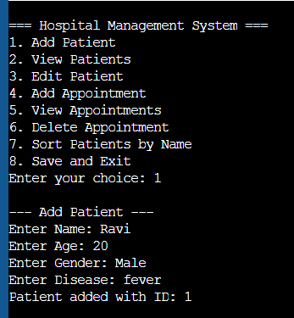
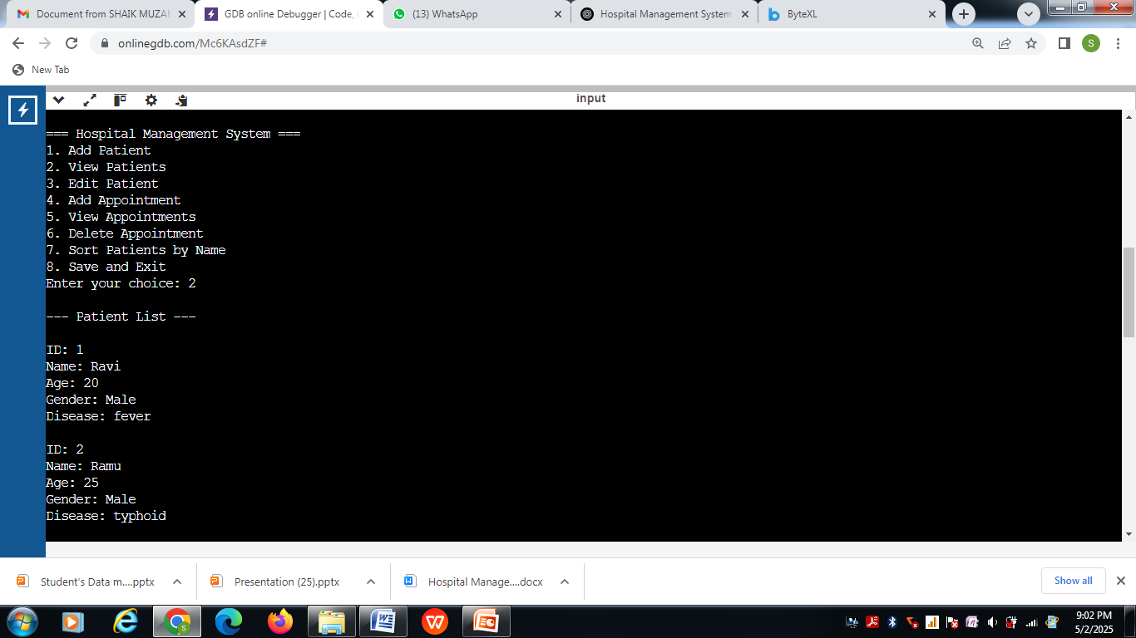
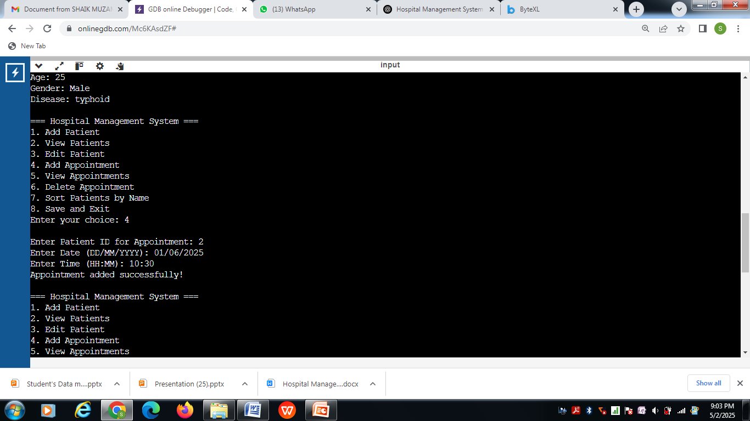
SAMPLE OUTPUT

Slide 13
CONCLUSION :
The Hospital Management System (HMS) implemented in C is a crucial tool for efficiently managing various hospital operations and workflows.
In conclusion, this Hospital Management System in C proves to be a valuable project that streamlines hospital operations, and with further enhancements, it can become a comprehensive tool for healthcare facilities.

Slide 14
THANK YOU

